Slide 1
BRAIN TUMOUR DETECTION USING MRI IMAGES
Made By: Navya Khurana

Slide 2
INTRODUCTION
Recent advancements in machine learning (ML) and deep learning (DL), particularly Convolutional Neural Networks (CNNs), have shown promising results in automating brain tumor detection from MRI images. CNNs are a type of deep neural network that excels at analyzing visual data, making them ideal for tasks like image classification, segmentation, and detection.
By training models on large datasets of MRI images, these algorithms can learn to recognize patterns and features that are indicative of tumors, including abnormal shapes, textures, and regions of interest. The resulting model can then automatically classify images as either containing a tumor or not, and even differentiate between benign and malignant tumors.

Slide 3
OBJECTIVES OF THE PROJECT
Automated Tumor Detection from MRI Images: A fully automated system that can classify MRI images into tumor and non-tumor categories.
Segmentation of Tumor Regions:The model will not only classify whether a tumor is present but also segment the tumor's region, helping radiologists to focus on affected areas.

Slide 4
Accuracy Improvement Through Deep Learning Models: The model will be capable of achieving performance metrics that meet or exceed traditional human diagnostic accuracy.
Real-Time MRI Image Analysis :he model can quickly classify MRI images, offering medical practitioners faster insights for timely decision-making.

Slide 5
SCOPE OF THE PROJECT
Dataset: Utilizing MRI scans for brain tumor detection, focusing on both tumor and non-tumor images, and potentially classifying 4 types of tumors as Glioma , Meningioma , Notumor ,Pituitary.
Model Development: Using deep learning models like VGG16 for binary classification (tumor vs. no tumor) and tumor segmentation.
Evaluation: Assessing the model using key metrics such as accuracy, precision, recall, and F1-score.
Real-Time Analysis: Providing quick tumor detection and segmentation to assist medical professionals in diagnosis.
User Interface: Developing a simple interface for uploading MRI images and receiving results

Slide 6
Model Used
VGG16 is a convolutional neural network (CNN) architecture that has been widely used in image classification tasks, including medical image analysis. VGG16 is commonly used with pretrained weights (e.g., on the ImageNet dataset), which allows the model to learn general features (edges, textures, etc.) that can be transferred to new tasks. This transfer learning technique speeds up training and improves performance, especially when the dataset is small or when you're working with specialized images like MRI scans.

Slide 7
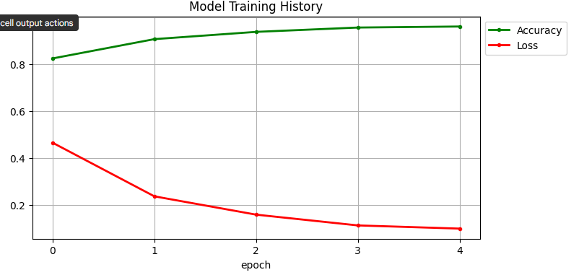
LOSS vs ACCURACY

Slide 8
EXPLANATION OF THE GRAPH
Decreased loss and increased accuracy after 5 epochs indicate that the model is learning effectively and becoming better at distinguishing between the tumor and non-tumor classes
.Loss reduction shows that the model is improving its predictions, and increased accuracy means it is correctly classifying more samples.
This is a sign that the model is successfully training and improving its ability to generalize to the MRI data, which is essential for effective brain tumor detection.

Slide 9
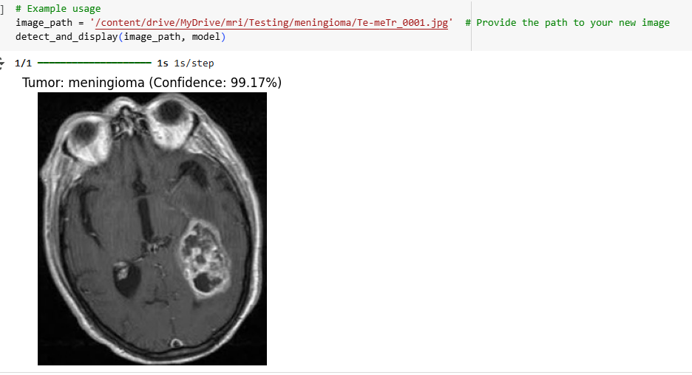
EXAMPLES OF TUMOUR DETECTION

Slide 10
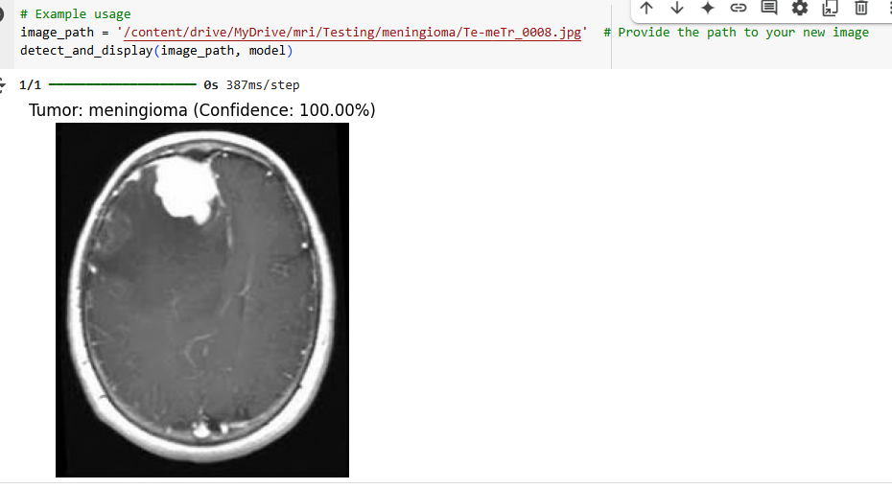

Slide 11
